Slide 1
Big O Notation
(not the anime)

Slide 2
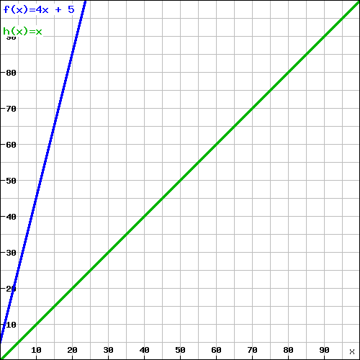
A Linear Example
f(x) = 4x + 5
f(5) = 4(5) + 5 = 25
f(100) = 4(100) + 5 = 405
f(5000) = 4(5000) + 5 = 20,005
h(x) = x
h(5) = 5
h(100) = 100
h(5000) = 5000
Both graphs grow at a linear rate.

Slide 3
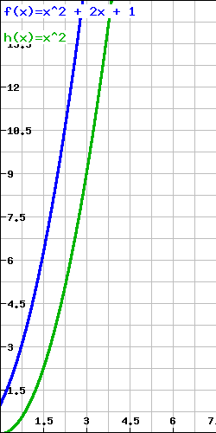
A Quadratic Example
f(x) = x² + 2x + 1
f(5) = (5)² + 2(5) + 1 = 36
f(100) = (100) ² + 2(100) + 1 = 10,201
f(5000) = (5000) ² + 2(5000) + 1 = 25,010,001
h(x) = x²
h(5) = (5) ² = 25
h(100) = (100) ² = 10,000
h(5000) = (5000) ² = 25,000,000
Both graphs grow at a
quadratic rate.

Slide 4
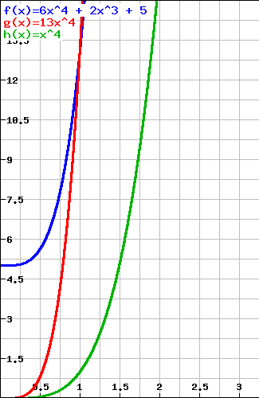
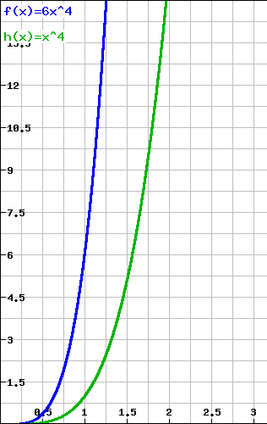
A Polynomial Example
6x⁴ + 2x³ + 5
=
O(x⁴)
|6x⁴ + 2x³ + 5| <= 6x⁴ + 2x³ + 5
<= 6x⁴ + 2x⁴ + 5x⁴
<= x⁴ (6 + 2 + 5)
<= 13x⁴
|6x⁴ + 2x³ + 5| <= 13|x⁴|

Slide 5
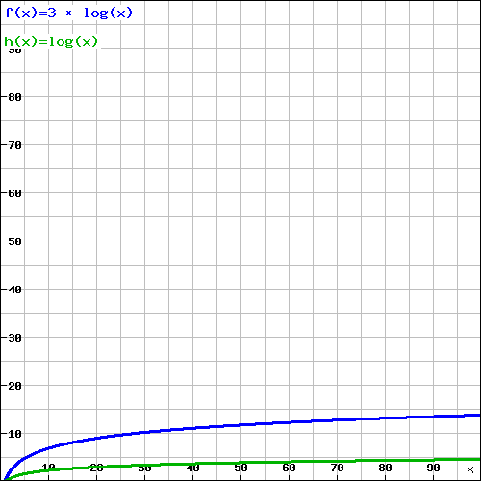
A Logarithmic Example
Over time, regardless of the constant coefficient 3, the graph 3log(x) still maintains a similar shape/growth to the graph of log(x).
3log(x) = O(log(x))
Both graphs grow at a logarithmic rate.

Slide 6

The End
Big O says, “Thanks for listening.”

